Slide 1

Homework 2
Task 1.
Create 2 html files (tabular and block layout), each of which contains the following elements:
the total width of the blocks should be 100% of the screen (without scrolling);
all style attributes must be moved to a separate file (1 css file per 1 html file);
the use of different types of positioning is encouraged;
LeverX Presentation. Copyrighted 2019 by LeverX, Inc. All Rights Reserved.

Slide 2

Homework 2
Task 2.
Create an html document and its corresponding css
document, implementing the following markup:
Task 3.
Create an html document and its corresponding css document,
implementing the following markup:
block - header, 90% width (5% left and right spaces) and 15%
height, rounded lower corners;
sidebar fixed menu (position: fixed), width - 10%, height - 600px. The background is translucent;
The menu contains references to tasks 1 and 2;
the central block consists of text and a numbered list;
the block - footer, contains the text. Width - 90%, indents to the right and left of 5%, height 15%, rounded upper corners).
LeverX Presentation. Copyrighted 2019 by LeverX, Inc. All Rights Reserved.

Slide 3
Homework 2
Task 4.
Create an html document and its corresponding css document, implementing the following markup:
1) block - header, width - 100%, height - 10%, changing the background color when hovering, translucent, containing 2 pictures (right and left, height aligned - in the middle, picture height - 80% of the header), positioning - fixed.
2) the main block - text in 2 columns, indents - 15% from the edge, contrast border on the side (right and left), colored background, indent from the footer - 50px.
3) the footer block contains 2-3 lines of text, 100% wide and up to 15% high. Translucent. Hovering becomes opaque (pseudo-classes + rgba).
LeverX Presentation. Copyrighted 2019 by LeverX, Inc. All Rights Reserved.

Slide 4
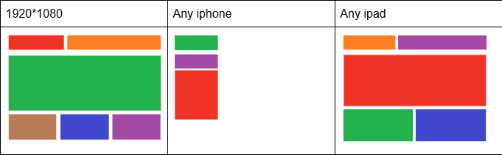
Homework 2
Task 5.
Create an html document and its corresponding css document, implementing the following markup:
LeverX Presentation. Copyrighted 2019 by LeverX, Inc. All Rights Reserved.

Slide 5
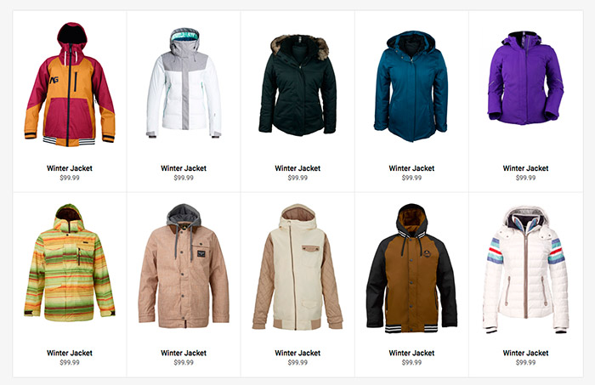
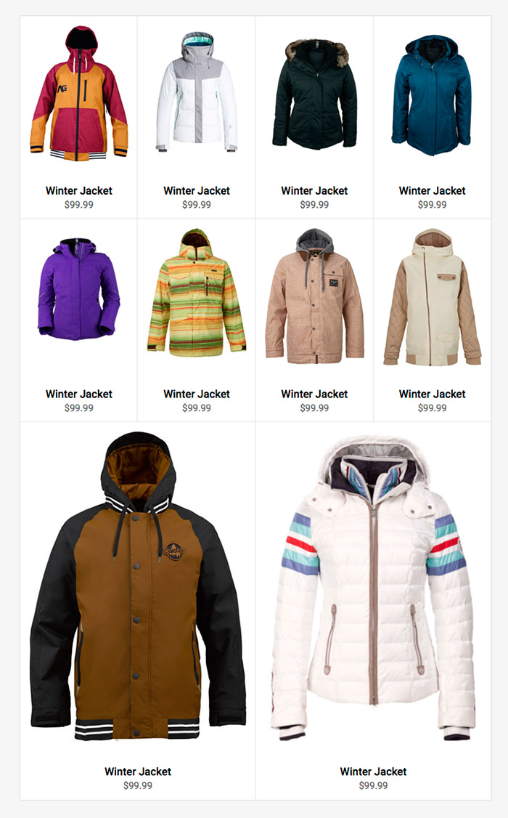
Homework 2
Task 6
Create an html document and its corresponding css document, implementing the following flex adaptive markup :
on 1920*1080
on 1280 x 1024
LeverX Presentation. Copyrighted 2019 by LeverX, Inc. All Rights Reserved.

